Slide 1


3D Bounding Box Estimation
Projektpraktikum Maschinelles Lernen
SS 2017
15.09.2017
S. Aklanoglu, T. Fuhrmann

Slide 2
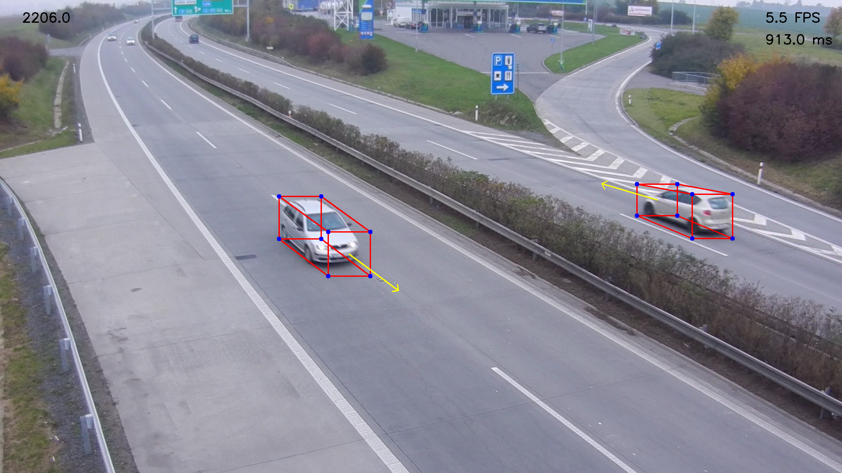
1. Motivation
Goal: 3D bounding box and moving direction annotations for traffic surveillance
Approach similar to: Automatic Camera Calibration for Traffic Understanding (Dubska et al. 2014)
Additional Conditions:
Easiest approach
At least 10 FPS

Slide 3
Motivation
2D – Bounding Box
Silhouette Extraction
3D – Bounding Box
Demo
1st STAGE
Goal
Background
2nd STAGE
CNN
Tensorbox
3rd STAGE
Backgroundsubstraction
Convex Hull
4th STAGE
Vanishing Points
Tangents
5th STAGE
Results

Slide 4
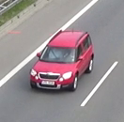
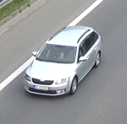
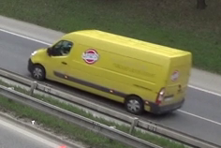
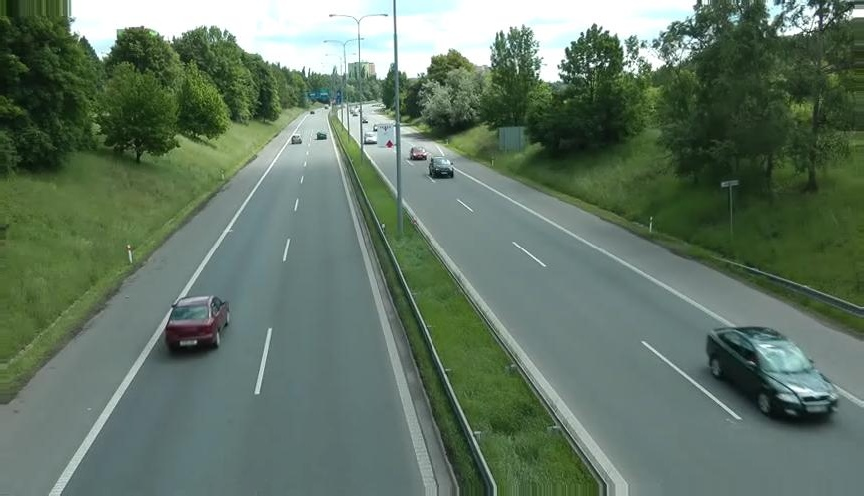
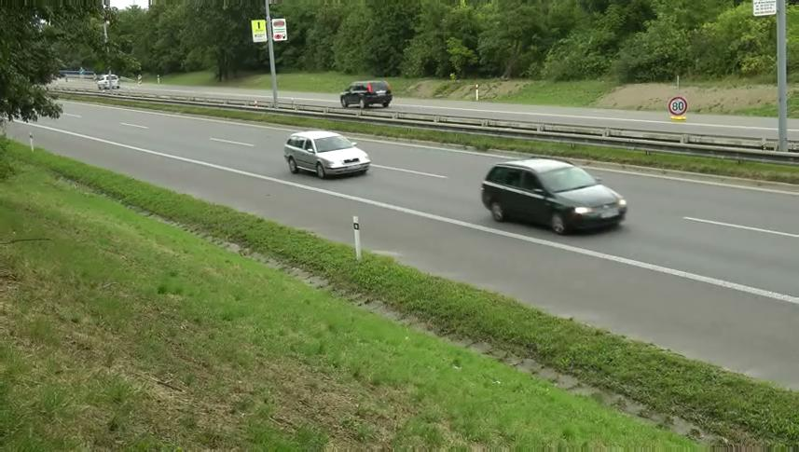
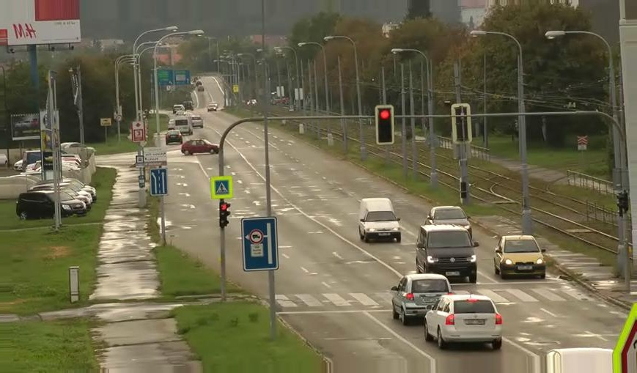
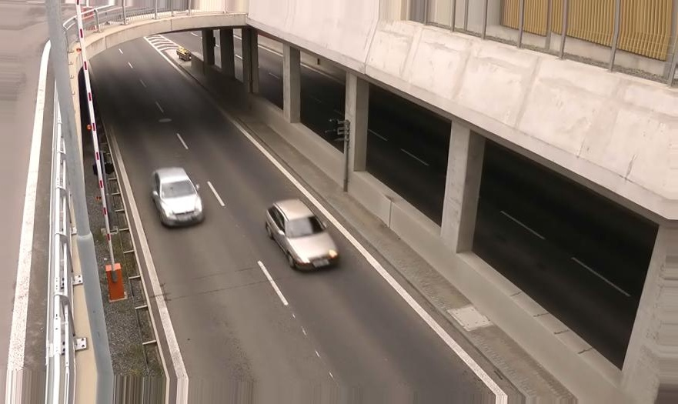
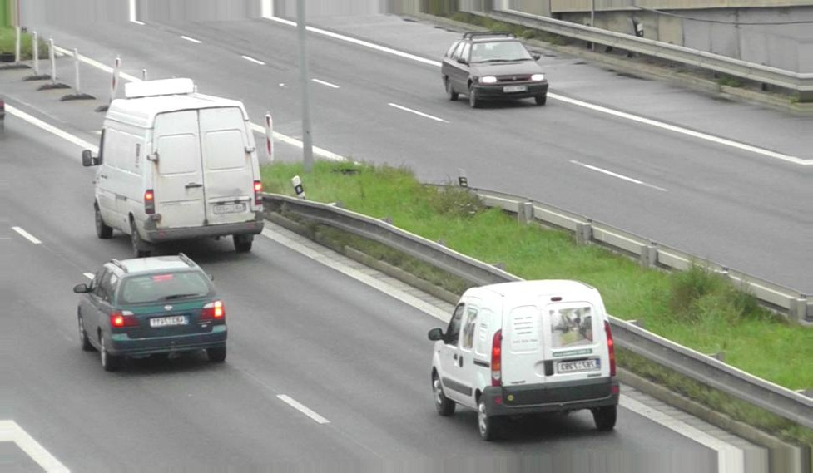
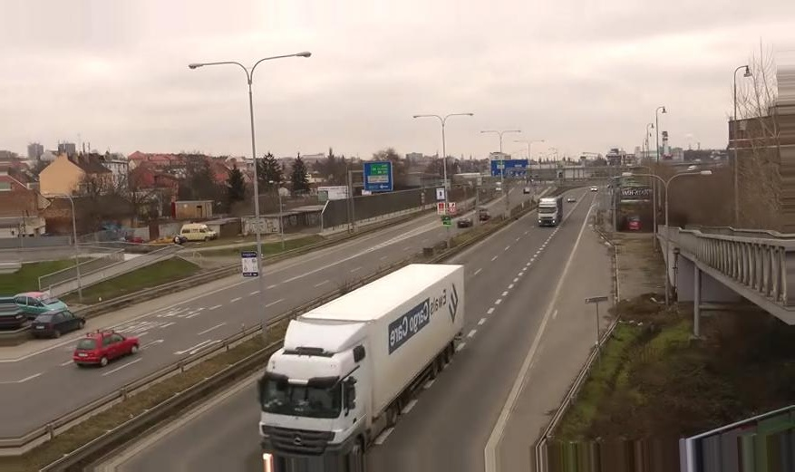
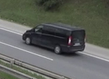
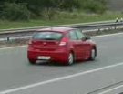
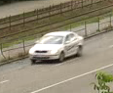
2. 2D – Bounding Box
Idea: Detect 2D bounding boxes and calculate convex hull within bounding boxes
Problem: Dataset with high quality annotations is needed
Solution: Training different CNNs with different datasets in TensorBox
BoxCars116K
COD20K
3

Slide 5
2. 2D – Bounding Box
 | BoxCars116K |  |  | COD20K
 | Inception V1 | Resnet 100 | VGG 19 | Inception V1 | Resnet 100 | VGG 19
W x H | 224x224 | 224x224 | 224x224 | 864x480 | 864x480 | 864x480
Time (s)
3

Slide 6
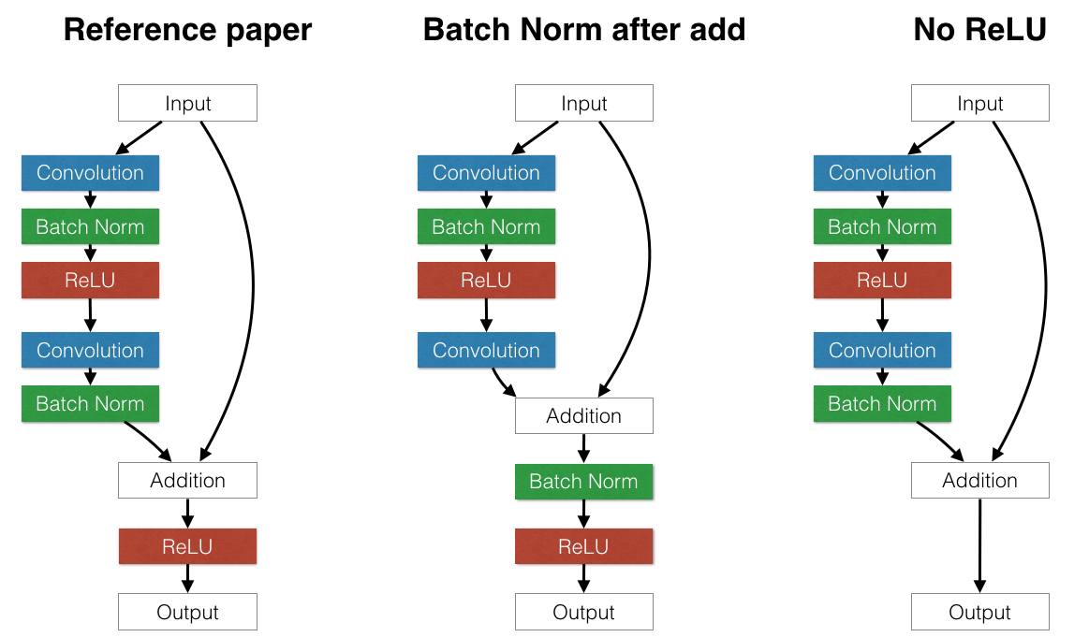
2. 2D – Bounding Box
BESCHREIBUNG RESNET BZW. AUSGEWÄHLTES NETZ UND VORGEHEN VON TENSORBOX IN BILDERN ILLUSTRIERT
4

Slide 7
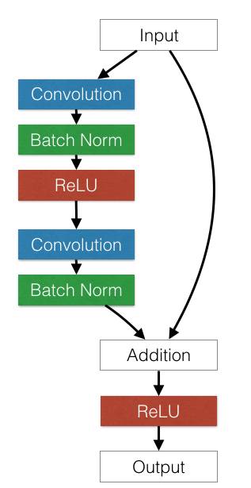
2. 2D – Bounding Box
BESCHREIBUNG RESNET BZW. AUSGEWÄHLTES NETZ UND VORGEHEN VON TENSORBOX IN BILDERN ILLUSTRIERT
4

Slide 8
2. 2D – Bounding Box
BESCHREIBUNG RESNET BZW. AUSGEWÄHLTES NETZ UND VORGEHEN VON TENSORBOX IN BILDERN ILLUSTRIERT
https://arxiv.org/pdf/1512.03385.pdf RESNET100
http://www.image-net.org/challenges/LSVRC/2013/slides/overfeat_ilsvrc2013.pdf
http://mdlai.com/2016/03/29/player-tracker/
4

Slide 9
2. 2D – Bounding Box
 | BoxCars116K |  |  | COD20K
 | Inception V1 | Resnet 100 | VGG 19 | Inception V1 | Resnet 100 | VGG 19
Accuracy
IOU
FP
5

Slide 10
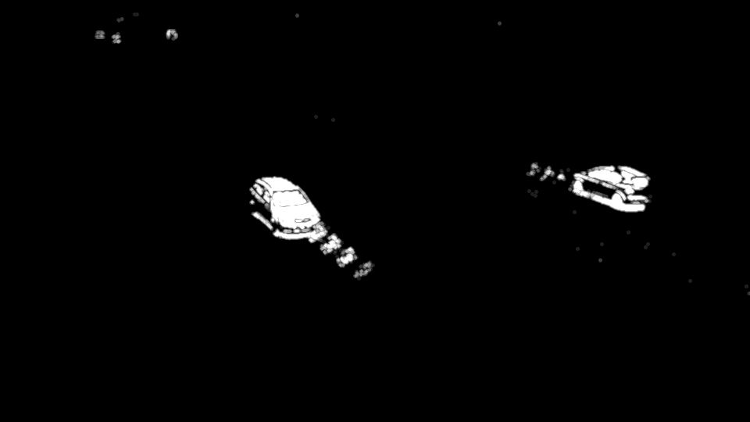
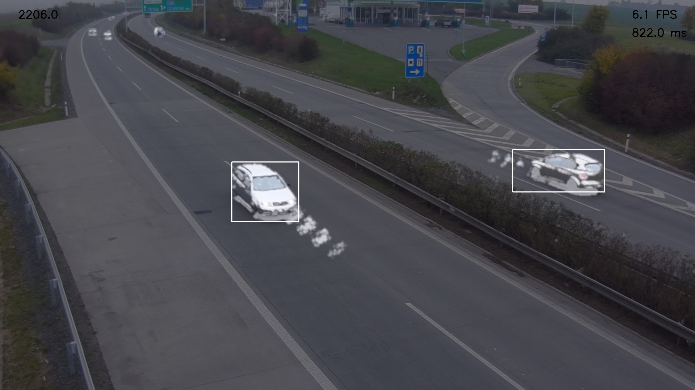
3. Silhouette Extraction
Divided in 2 steps:
Background subtraction with opencv3 (KNN approach) with shadow filtering; first 10 frames of video will be used for pre-rendering ZEIT IN MS
6

Slide 11
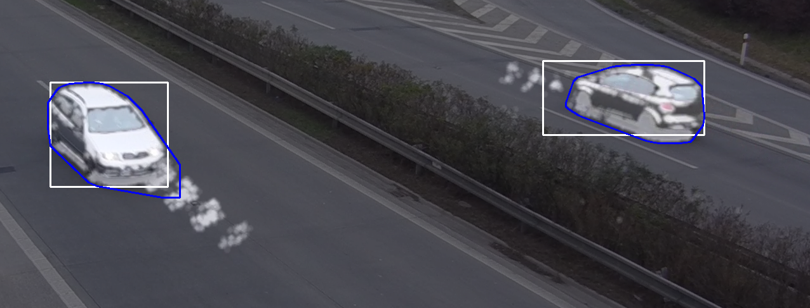
3. Silhouette Extraction
Divided in 2 steps:
Convex hull calculation with opencv3 ZEIT IN MS
7

Slide 12
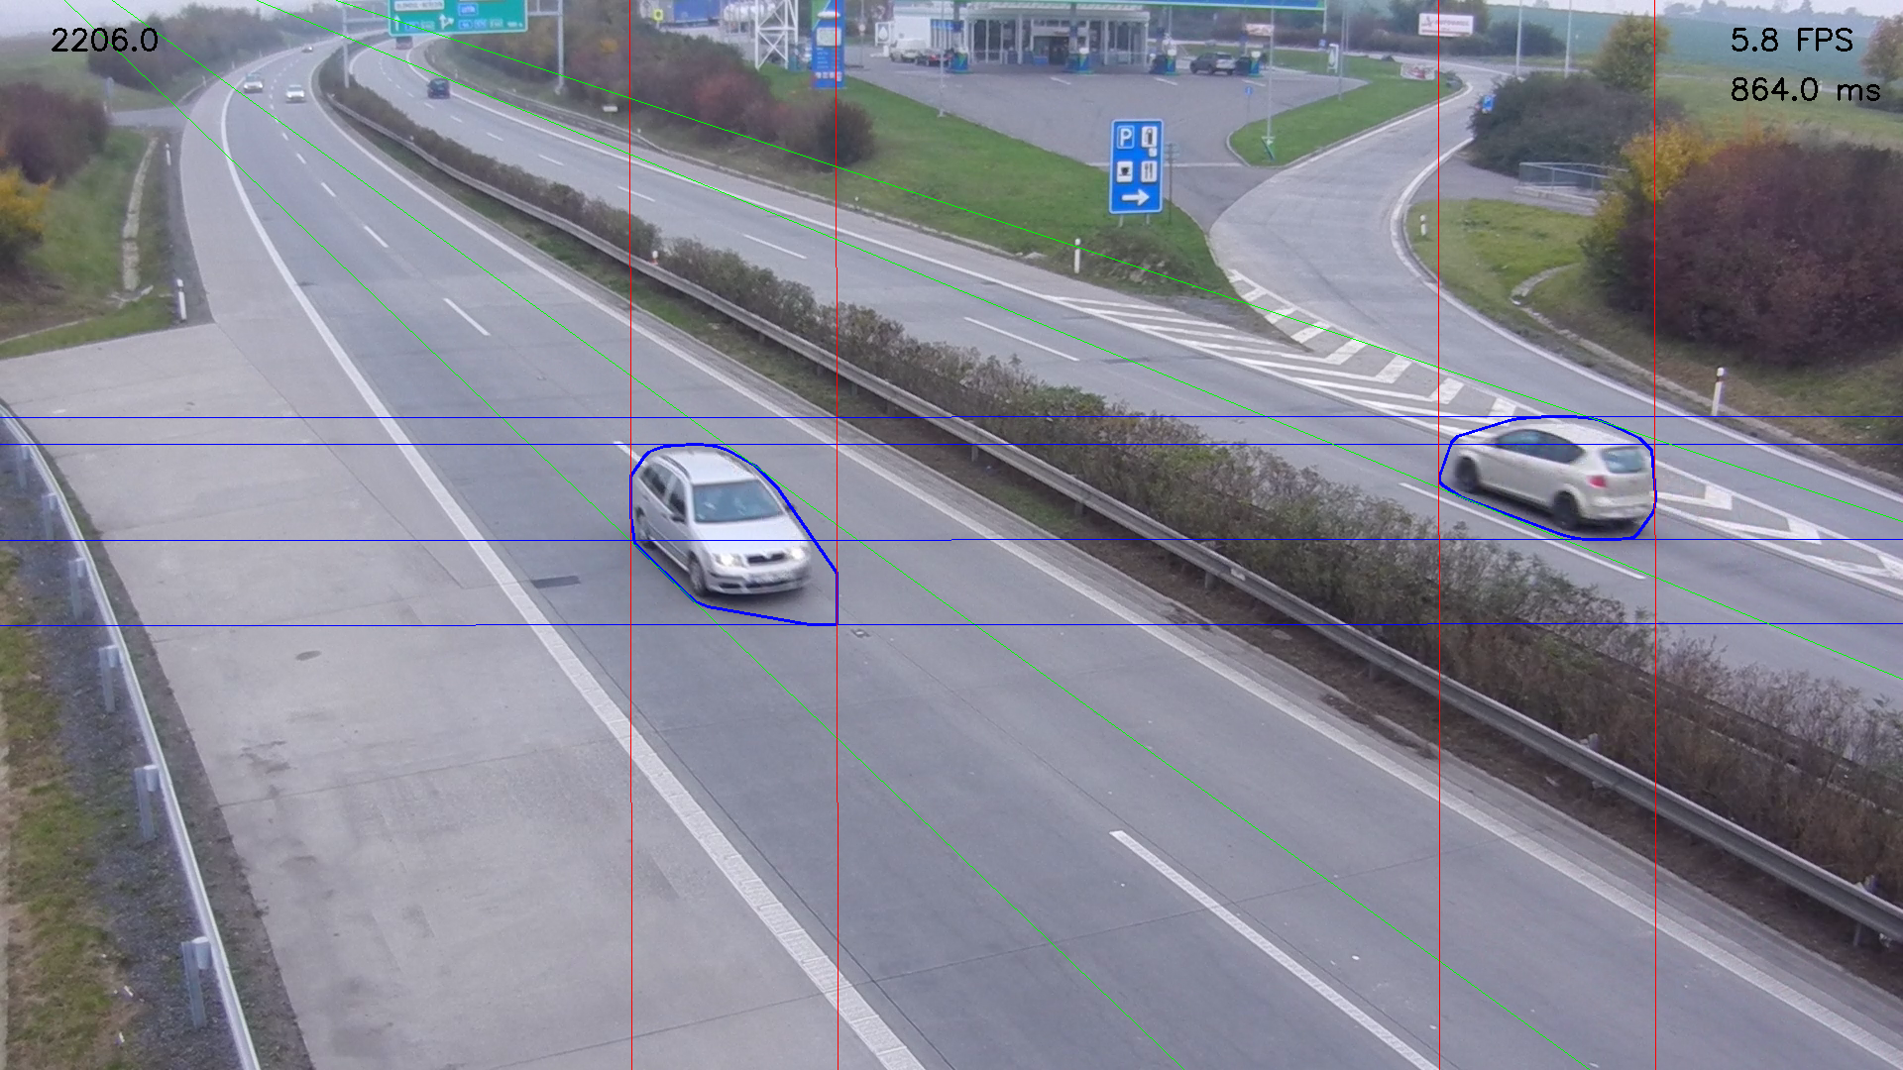
4. 3D – Bounding Box
VP1
VP2
(inf)
VP3 (inf)
8

Slide 13

4. 3D – Bounding Box
9

Slide 14

4. 3D – Bounding Box
9

Slide 15
4. 3D – Bounding Box
9

Slide 16
Demo

Slide 17
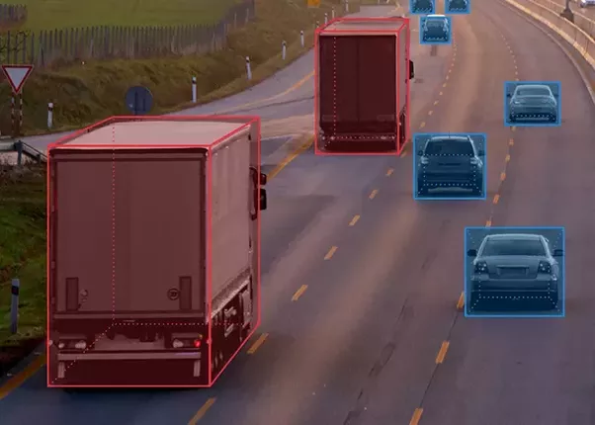
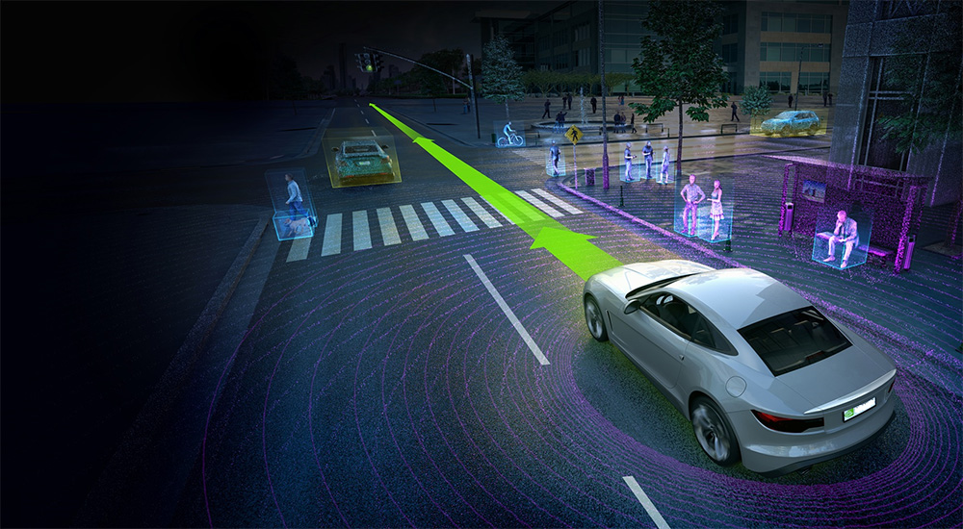
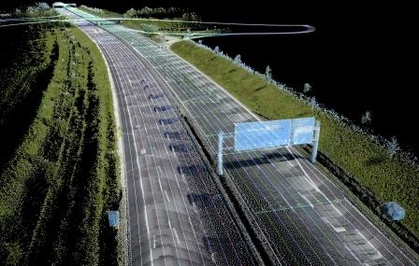
Questions?

